Slide 1
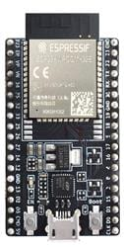
ESP32 NOW
ESP32 NOW
Slave
Masters
Masters

